Slide 1
Software Engineering Design

Slide 2
Definitions
Software Design:
Software design is the process of specifying the nature and composition of a software system that satisfies client needs and desires, subject to constraints. (Fox, 2006)
Software Engineering Design:
Software engineering design is the process of specifying programs and sub-systems, and their constituent parts and workings, to meet software product specifications. (Fox, 2006)

Slide 3
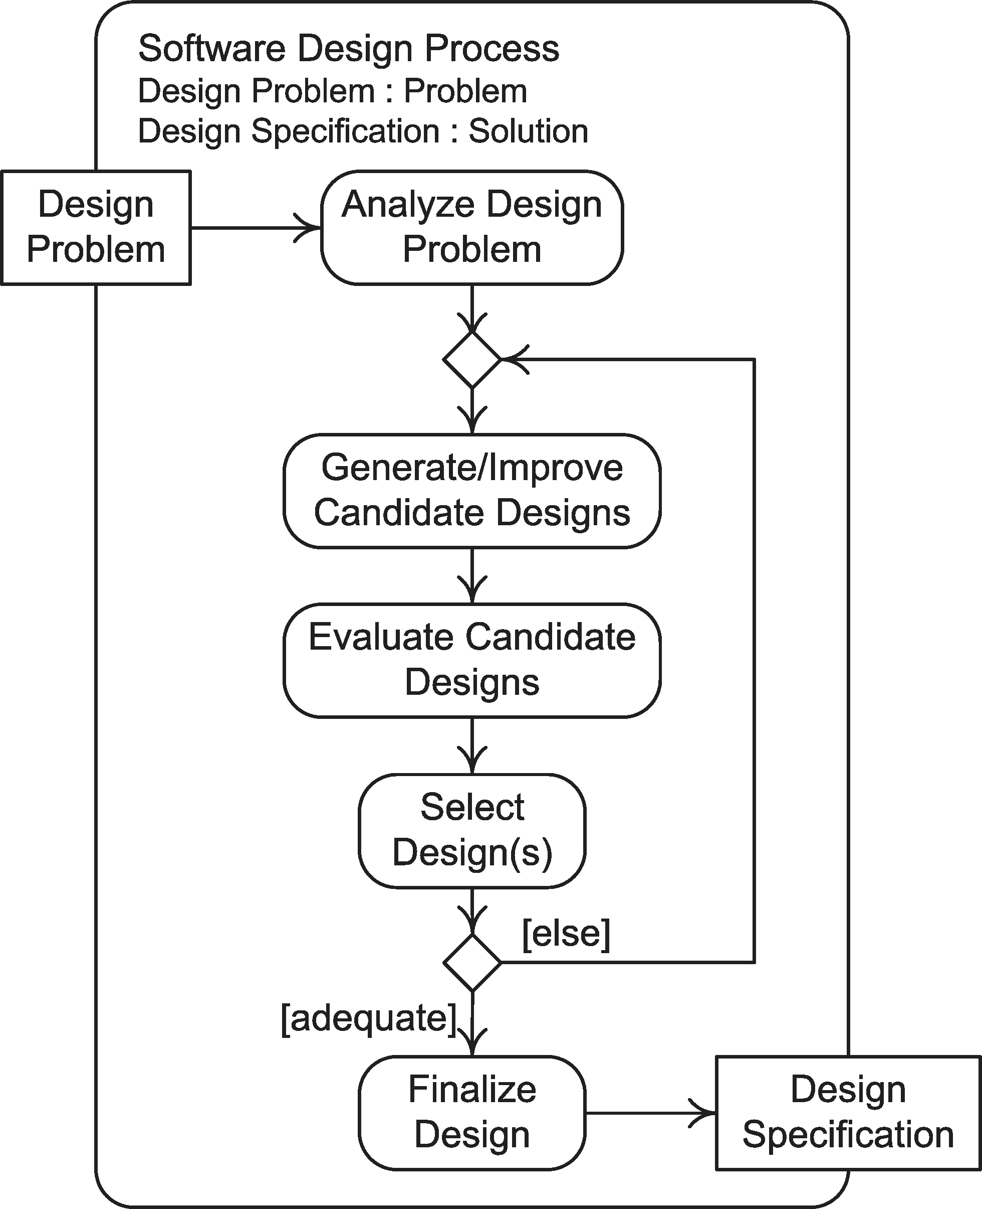
The Process
The general software Design process

Slide 4
Parts of the Process
Analysis:
Understanding the problem
Resolution:
Solving the problem

Slide 5
Design Principles
Evaluating Software Designs

Slide 6
Overview
Rationale
Qualitative Goals
The Fundamental Principle
Other Software Design Principles

Slide 7
Rationale
Generation of Alternative:
Several alternative designs should/will be developed
Evaluation of Alternatives:
Some "measure(s)" must be used to evaluate/compare alternatives
They can be quantitative or qualitative "measures" of quality

Slide 8
The Fundamental Principle of Engineering Design
The Principle:
Designs should be modular
The Rationale:
Understanding is inversely proportional to scope/scale (due, in part, to human memory limitations of 7±2 "chunks")
Small (and simple) components are easier to debug and fix than large (and complex) components
Reusability is inversely proportional to scope/scale
Systems constructed from small (and simple) components are more portable

Slide 9
Modular Designs: Things to Think About
Decomposability:
Do the modules aid in decomposition (i.e., top-down development)?
Composability:
Do the modules aid the constructions of new systems (i.e., bottom-up development)?
Continuity:
Do the modules "localize" small changes?
Protection:
Do the modules confine problems?

Slide 10
Some Other Software Design Principles
Standardization
Simplicity
Elegance/Beauty

Slide 11
Standardization
The Principle:
Use standard designs, algorithms, data structures, and documentation practices if possible
The Rationale:
Easier to understand and use
More likely to be re-used
More likely to be portable

Slide 12
Simplicity
The Principle:
Simpler designs are better
The Rationale:
Easier to understand and use
More likely to be re-used
To Think About:
Have I developed a complex solution to a simple problem?

Slide 13
Elegance/Beauty
The Principle:
Elegance matters
The Rationale:
Elegant modules are more likely to be re-used
Elegance is usually directly proportional to clarity

Slide 14
Software Design Practices
Information Hiding
Coupling
Cohesion

Slide 15
Information Hiding
The Principle:
Hide the internal details of a component from all other components
The Rationale:
Prevents damage from errant external code
You can't hurt what you can't see
Makes components easier to understand/use
It enhances abstraction (i.e., shields users from the details)
Simplifies modification and repair
Changing internal details should not have any impact other components
Facilitates re-use

Slide 16
Information Hiding (cont.)
Examples of Private Information:
Local variables, data types, and data structures
Internal flow of control
Algorithms
Examples of Public Information:
Interface information (inputs and outputs)
Behavior/Functionality
Errors and exceptions

Slide 17
Coupling
The Principle:
Minimize the coupling between modules
The Rationale:
Strongly coupled modules are difficult to change
Strongly coupled modules are difficult to debug
Weakly coupled/decoupled modules are easier to understand
Weakly coupled/decoupled modules are more likely to be re-used

Slide 18
Coupling (cont.)
Techniques:
Information hiding decreases coupling
The use of global entities increases coupling
Modules that communicate complex data structures are more tightly coupled
To Think About:
Could I use module A elsewhere without module B?

Slide 19
Levels of Coupling
Direct Coupling:
Modules share variables
Common Coupling:
Modules share "global"/"common" variables
Import/Export Coupling:
Only share variables/operations that are explicitly "exported"

Slide 20
Cohesion
The Principle:
The parts of a module should be closely related to each other.
The Rationale:
Highly cohesive modules are easier to understand (like a well-written paragraph and document)
High cohesion tends to reduce coupling between modules
Separation of Concerns

Slide 21
Cohesion (cont.)
Techniques:
Separate input, input validation, calculations, and output
Modules should not cross levels of abstraction
Design modules that relate to real-world entities
To Think About:
Does this module have a single, clear responsibility?

Slide 22
Levels of Cohesion
Coincidental Cohesion:
No meaningful connection
Logical Cohesion:
Collection of functionally related components (e.g., I/O)
Temporal Cohesion:
Functions are executed together (e.g., initialization)
Abstract Cohesion:
Module provides services associated with a single data type

Slide 23
Exercise

Slide 24
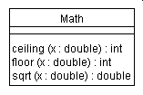
Examples
Design 1:
Discussion:
It's OK but the methods should be static.

Slide 25

Examples (cont.)
Design 2:
Discussion:
The class is not cohesive.

Slide 26

Examples (cont.)
Design 3:
Discussion:
The classes are strongly coupled. The Calculator would not have to use messages[].

Slide 27

Examples (cont.)
Design: 4
Discussion:
It isn't cohesive. Though the buttons seem similar, they aren't. Some are in the elevator and some are outside of the elevator. So, it would be better to have an Elevator class and a CallStation class.

Slide 28
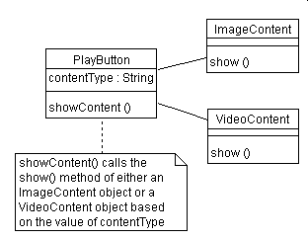
Examples (cont.)
Design: 5
Discussion:
It is tightly coupled. It could be improved by adding a Content interface.

Slide 29
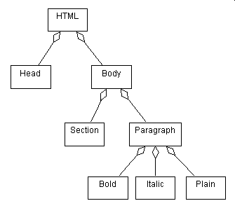
Examples (cont.)
Design: 6
Discussion:
It isn't a good design because, in the real world, Bold, Italic and Plain do not have a part-whole relationship to Paragraph.

Slide 30

Examples (cont.)
Design: 7
Discussion:
It is not cohesive. A better design would be to have a ZipCodeReader class and a PostageFinder class.

